Slide 1
PET328
COMPUTER APPLICATIONS IN PETROLEUM ENGINEERING

Slide 2

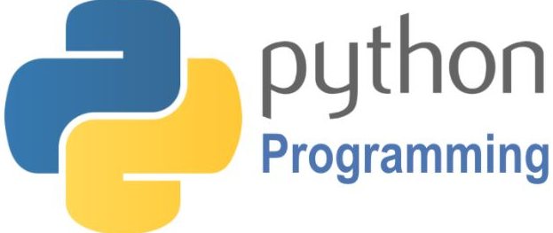
PET328: COMPUTER APPLICATIONS IN PETROLEUM ENGINEERING
(With Python Programming)
Olatunde O. Mosobalaje (PhD)
Department of Petroleum Engineering,
Covenant University, Ota
Nigeria

Slide 3


PET 328: Computer Applications in Petroleum Engineering – with Python Programming Dr. Mosobalaje, O. O.
OUTLINE
Preambles
The Appetizer
The Toolbox
The Embedded Course
Introduction to Computer Programming
Getting Started with Python
Basic Python Objects
Conditional Execution
Repeated Execution
Functions
Python Data Structures
Strings
Lists
Tuples
Dictionaries
Some Python Libraries
NumPy
Matplotlib
Pandas
Scikit-learn
Application Projects
Oil Reservoir Volumetrics
Material Balance Analysis
PVT Properties

Slide 4
PET 328: Computer Applications in Petroleum Engineering – with Python Programming Dr. Mosobalaje, O. O.
PREAMBLES
The Appetizer – a presentation
ACQUIRING NASCENT SKILLS FOR EMERGING OIL AND GAS OPPORTUNITIES: DATA ANALYTICS, MACHINE LEARNING AND ARTIFICIAL INTELLIGENCE

Slide 5
PET 328: Computer Applications in Petroleum Engineering – with Python Programming Dr. Mosobalaje, O. O.
PREAMBLES
The Toolbox
For this course, the following tools would be needed:
Python 3
Python Integrated Development and Learning Environment (IDLE)
Git and GitHub

Slide 6
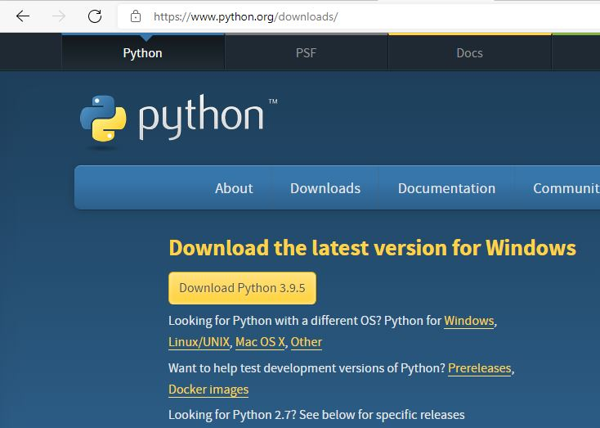
PET 328: Computer Applications in Petroleum Engineering – with Python Programming Dr. Mosobalaje, O. O.
PREAMBLES
The Toolbox
Installing Python 3
To install the latest release of Python 3, go to Python download website: https://www.python.org/downloads/

Slide 7
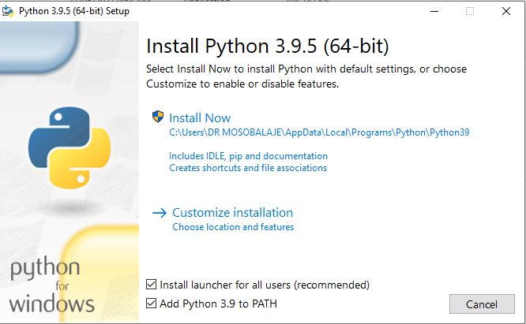
PET 328: Computer Applications in Petroleum Engineering – with Python Programming Dr. Mosobalaje, O. O.
PREAMBLES
The Toolbox
Installing Python 3
Launch the downloaded executable file by double-clicking the file in your download folder.
Follow the steps as the installer leads
Click on the default installation option.
Ensure to check the Add Python 3.9 to PATH

Slide 8
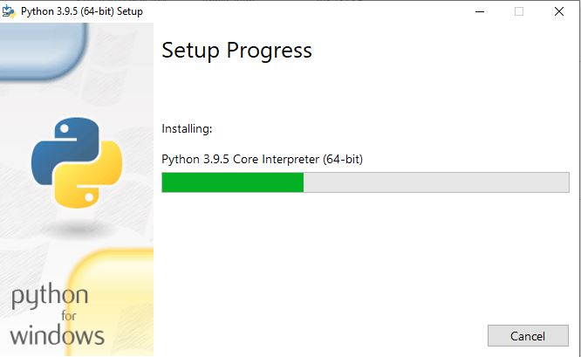
PET 328: Computer Applications in Petroleum Engineering – with Python Programming Dr. Mosobalaje, O. O.
PREAMBLES
The Toolbox
Installing Python 3

Slide 9
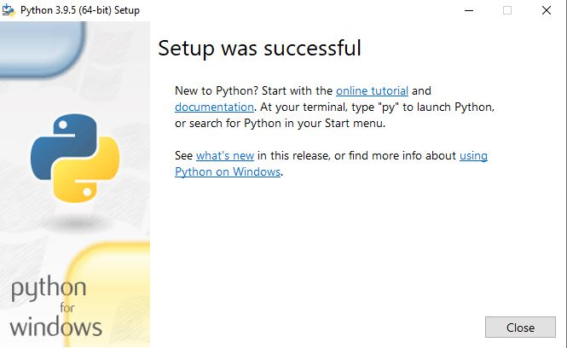
PET 328: Computer Applications in Petroleum Engineering – with Python Programming Dr. Mosobalaje, O. O.
PREAMBLES
The Toolbox
Installing Python 3
Click the close button when the installation is completed

Slide 10
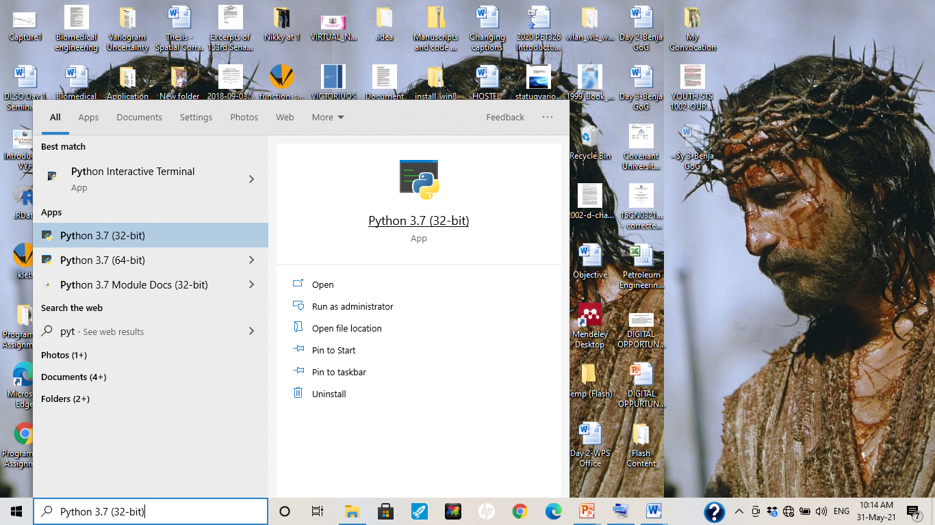
PET 328: Computer Applications in Petroleum Engineering – with Python Programming Dr. Mosobalaje, O. O.
PREAMBLES
The Toolbox
Launching Python 3
Simply type Python into the Start Menu search box and click the Python program.

Slide 11
PET 328: Computer Applications in Petroleum Engineering – with Python Programming Dr. Mosobalaje, O. O.
PREAMBLES
The Toolbox
Launching Python 3
Simply type Python into the Start Menu search box and click the Python program.

Slide 12
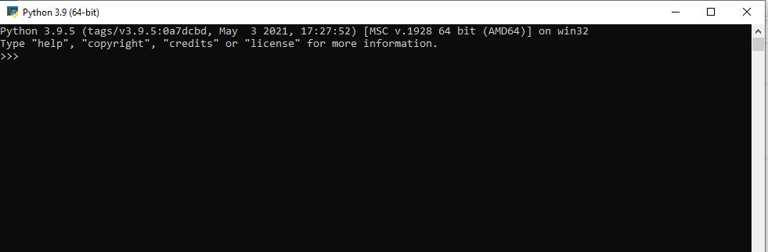
PET 328: Computer Applications in Petroleum Engineering – with Python Programming Dr. Mosobalaje, O. O.
PREAMBLES
The Toolbox
Launching Python 3

Slide 13
PET 328: Computer Applications in Petroleum Engineering – with Python Programming Dr. Mosobalaje, O. O.
PREAMBLES
The Toolbox
Python IDLE
Now, the Python DOS-like environment seems boring. Good enough, we will typically not be working on that platform; rather we will interact with Python from a platform known as Interactive Development and Learning Environment (IDLE)

Slide 14
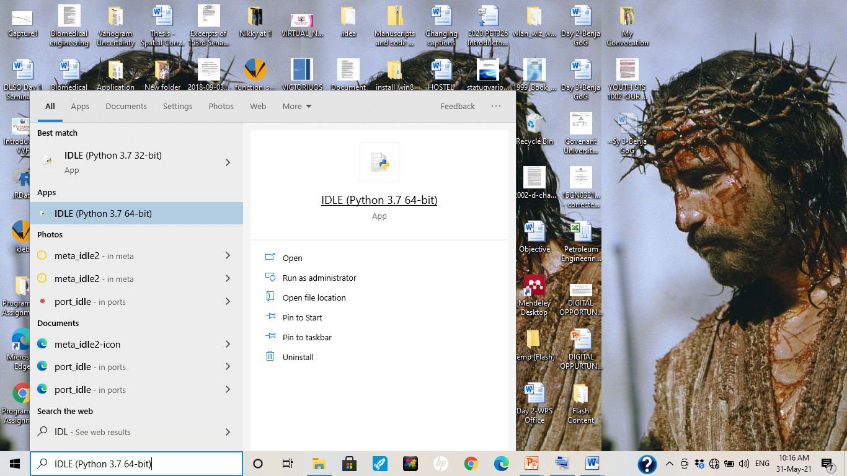
PET 328: Computer Applications in Petroleum Engineering – with Python Programming Dr. Mosobalaje, O. O.
PREAMBLES
The Toolbox
Python IDLE
To launch IDLE, simply type IDLE into the Start Menu search box and click on the IDLE program.

Slide 15
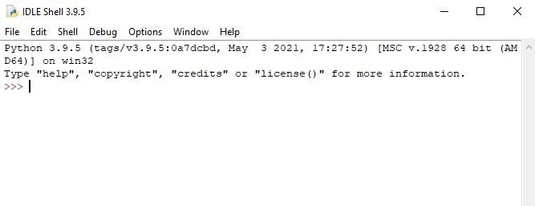
PET 328: Computer Applications in Petroleum Engineering – with Python Programming Dr. Mosobalaje, O. O.
PREAMBLES
The Toolbox
Python IDLE

Slide 16
PET 328: Computer Applications in Petroleum Engineering – with Python Programming Dr. Mosobalaje, O. O.
PREAMBLES
The Toolbox
Python IDLE
There are two ways by which you could communicate with Python from the IDLE environment:
Interactive
From a file (script)

Slide 17
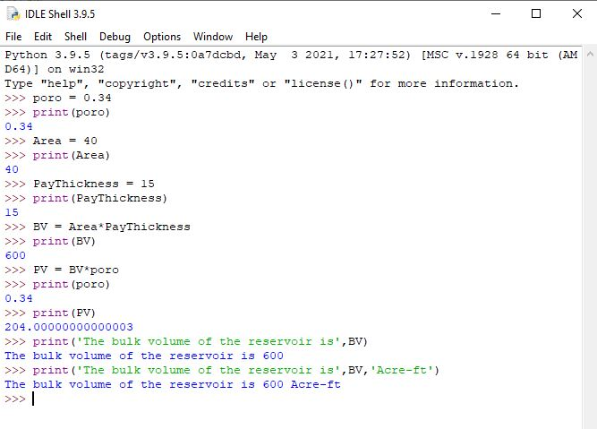
PET 328: Computer Applications in Petroleum Engineering – with Python Programming Dr. Mosobalaje, O. O.
PREAMBLES
The Toolbox
Communicating with Python interactively
In this case, you type in Python command (one at a time) into the console. Each command get executed once the ‘Enter’ key is pressed. Depending on the command, results may be displayed on the console once the command is executed.

Slide 18
PET 328: Computer Applications in Petroleum Engineering – with Python Programming Dr. Mosobalaje, O. O.
PREAMBLES
The Toolbox
Communicating with Python interactively
In this case, you type in Python command (one at a time) into the console. Each command get executed once the ‘Enter’ key is pressed. Depending on the command, results may be displayed on the console once the command is executed.

Slide 19
PET 328: Computer Applications in Petroleum Engineering – with Python Programming Dr. Mosobalaje, O. O.
PREAMBLES
The Toolbox
Communicating with Python from a file
In this case, you type in Python commands (all at a time) into a text file editor (code editor). The commands don’t get executed as they are being typed. Rather, they get executed (sequentially) when submitted as a whole to the Python interpreter.

Slide 20
PET 328: Computer Applications in Petroleum Engineering – with Python Programming Dr. Mosobalaje, O. O.
PREAMBLES
The Toolbox
Communicating with Python from a file
Any text editor program could be used for this purpose, as long as the file is saved as a .py file.
Good, Python has an in-built text editor for this purpose.

Slide 21
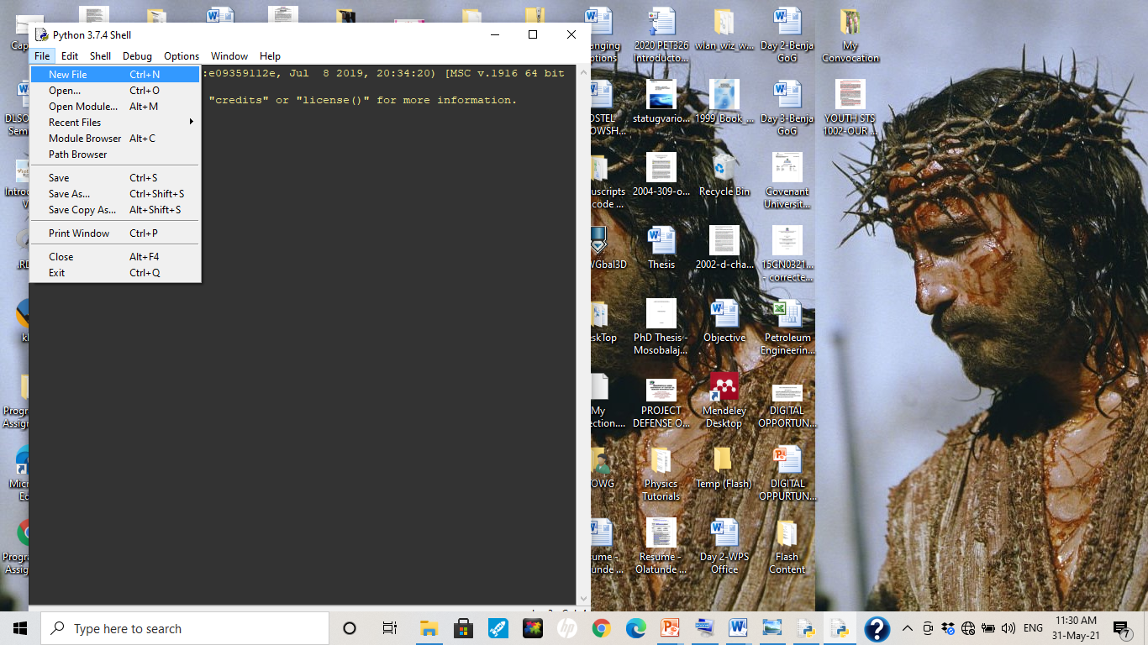
PET 328: Computer Applications in Petroleum Engineering – with Python Programming Dr. Mosobalaje, O. O.
PREAMBLES
The Toolbox
Communicating with Python from a file
To launch Python’s in-built code editor, just click on the File menu and choose New File.

Slide 22
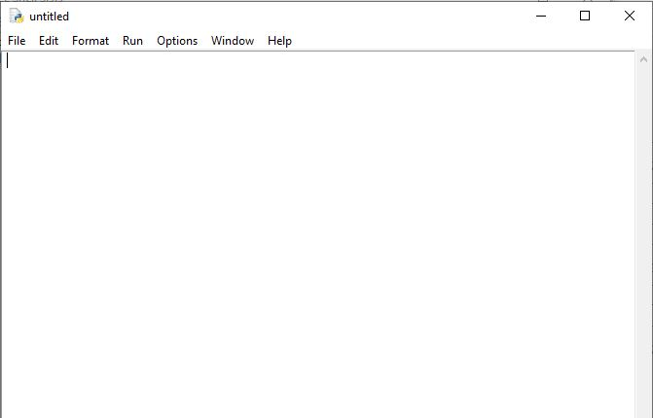
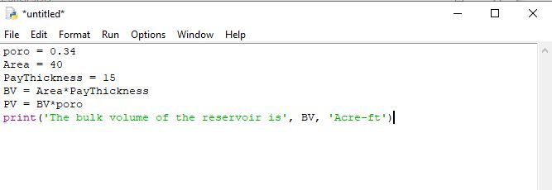
PET 328: Computer Applications in Petroleum Engineering – with Python Programming Dr. Mosobalaje, O. O.
PREAMBLES
The Toolbox
Communicating with Python from a file
Once the editor is opened, you can type in your lines of codes.

Slide 23
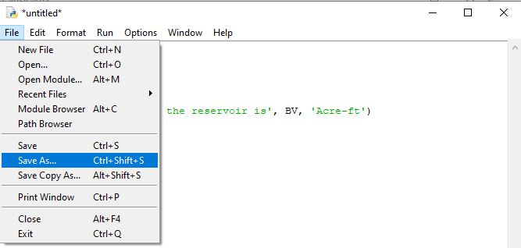
PET 328: Computer Applications in Petroleum Engineering – with Python Programming Dr. Mosobalaje, O. O.
PREAMBLES
The Toolbox
Communicating with Python from a file
Before submitting the lines of codes in the code editor to the Python interpreter, you need to save the editor file.
To save, simply go the File menu and choose Save As

Slide 24
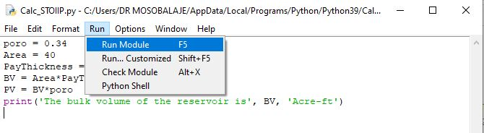
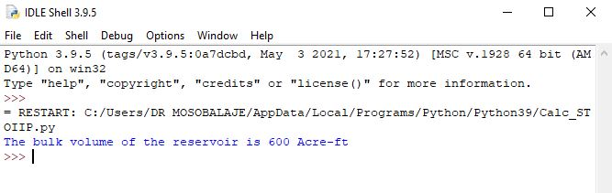
PET 328: Computer Applications in Petroleum Engineering – with Python Programming Dr. Mosobalaje, O. O.
PREAMBLES
The Toolbox
Communicating with Python from a file
Once the file (script) is saved, the code lines can be submitted to the Python interpreter by choosing item ‘Run Module’ in the Run menu.
The output of the code execution (if any) is subsequently displayed on the Python console.

Slide 25
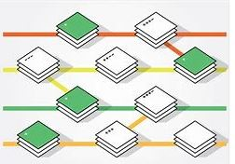

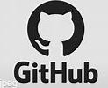
PET 328: Computer Applications in Petroleum Engineering – with Python Programming Dr. Mosobalaje, O. O.
PREAMBLES
The Toolbox
Git and GitHub
Git is an open source version control software.
What is Version Control?
Version control (VC) is a system used for keeping track of changes made to a file over time. As the changes are made, the system records and save the state of the file at instances indicated by the user. Such user can revert back to a previous version of the file when necessary.
Essentially, the VC system keeps the latest version of the file but also keeps a record of all changes between all versions.

Slide 26
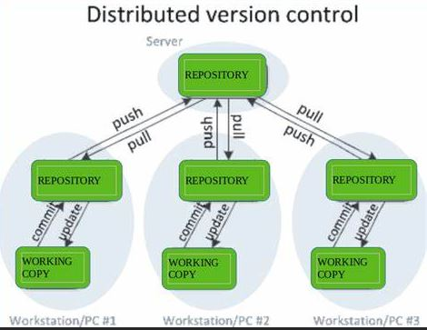
PET 328: Computer Applications in Petroleum Engineering – with Python Programming Dr. Mosobalaje, O. O.
PREAMBLES
The Toolbox
Git and GitHub
And, there is something called Distributed Version Control (DVC)
What is Distributed Version Control?
Typically, real life projects (including oilfield digital projects) are done by teams whose members need to collaborate – work together on same files. Individual members of the team can make changes to such shared files. There is therefore a need to make such file available on a central server and to keep track of the following:
who made what change?
When was the change made?
Why was the change made?

Slide 27
PET 328: Computer Applications in Petroleum Engineering – with Python Programming Dr. Mosobalaje, O. O.
PREAMBLES
The Toolbox
Git and GitHub
And, there is something called Distributed Version Control (DVC)
What is Distributed Version Control?
A version control system that also comes with the capabilities for collaboration among several people is known as Distributed Version Control system.
Git is a version control system – locally hosted on your system.
GitHub is an online platform that interfaces with Git, hosting your files on remote servers thereby making them available for collaboration with others.

Slide 28
PET 328: Computer Applications in Petroleum Engineering – with Python Programming Dr. Mosobalaje, O. O.
PREAMBLES
The Toolbox
Git and GitHub
In this course, we shall be working as a team, therefore, both Git and GitHub are part of tools we shall be using. Essentially, submissions to some assignments shall be in the form of code file editing and sharing between students and the Course Instructor.

Slide 29
PET 328: Computer Applications in Petroleum Engineering – with Python Programming Dr. Mosobalaje, O. O.
PREAMBLES
Assignment 1
Get the following tools ready on your PC:
Git - install
A user account on github.com
GitHub desktop - install

Slide 30

PET 328: Computer Applications in Petroleum Engineering – with Python Programming Dr. Mosobalaje, O. O.
PREAMBLES
The Embedded Course
A Coursera course is embedded into this course (PET328). It is compulsory that all students completes the Coursera course as it is part of the assessment items in PET328.

Slide 31
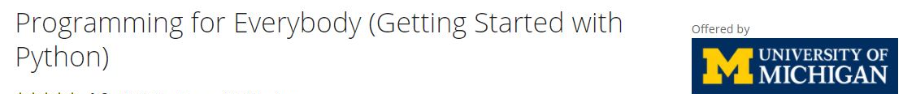
PET 328: Computer Applications in Petroleum Engineering – with Python Programming Dr. Mosobalaje, O. O.
PREAMBLES
The Embedded Course
The embedded course is titled ‘Programming for Everybody (Getting Started with Python).
The course is offered by University of Michigan.

Slide 32
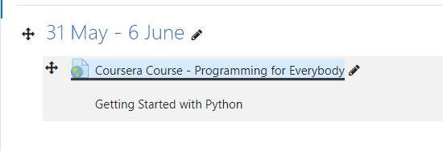
PET 328: Computer Applications in Petroleum Engineering – with Python Programming Dr. Mosobalaje, O. O.
PREAMBLES
The Embedded Course
The link to the embedded course has been added to the PET328 course site on Moodle.
To enroll for the Coursera course, simply click on the link.

Slide 33
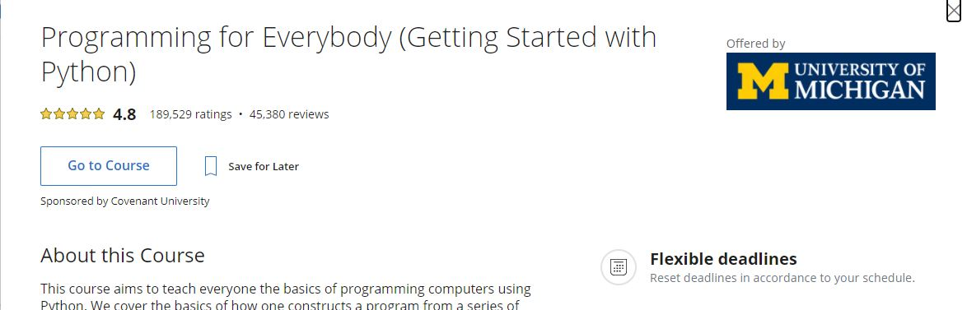
PET 328: Computer Applications in Petroleum Engineering – with Python Programming Dr. Mosobalaje, O. O.
PREAMBLES
The Embedded Course

Slide 34
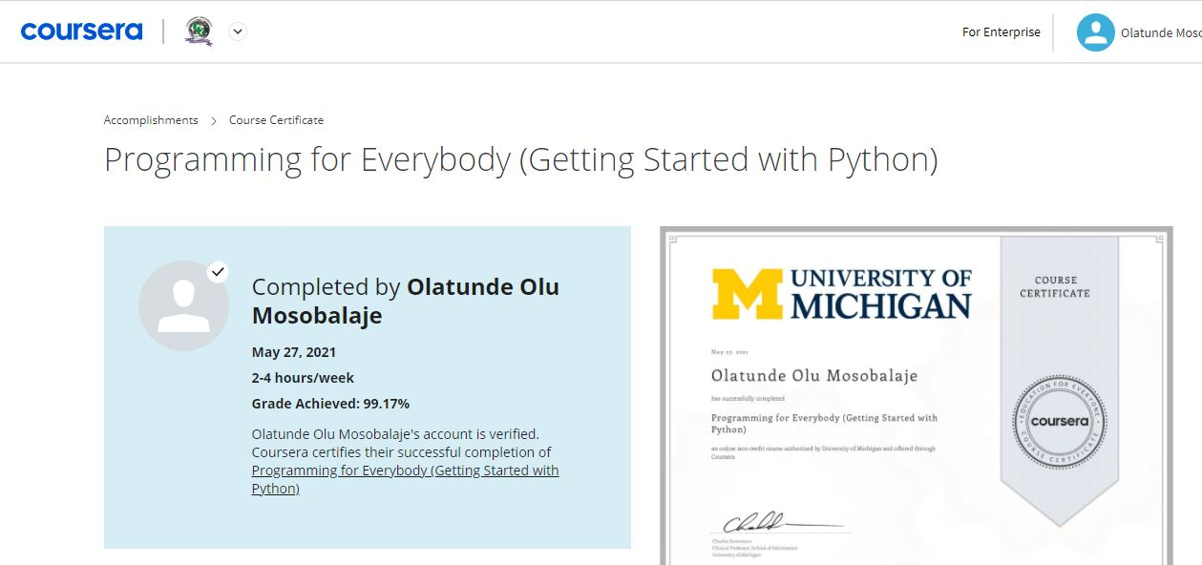
PET 328: Computer Applications in Petroleum Engineering – with Python Programming Dr. Mosobalaje, O. O.
PREAMBLES
The Embedded Course
When you complete the course, you are awarded a certificate of completetion!!!

Slide 35
PET 328: Computer Applications in Petroleum Engineering – with Python Programming Dr. Mosobalaje, O. O.
PREAMBLES
Introduction to Computer Programming
Analogy: Programming language vs. Natural language
There is a striking similarity between learning programming language and learning natural language. In both cases, the process is thus:
learn the vocabulary and the grammar – spell words, construct sentences etc.
Communicate
natural language: use words, sentences, paragraphs to communicate an idea
Programming language: use keywords, variables, functions, expressions, statements to communicate steps to computer.

Slide 36
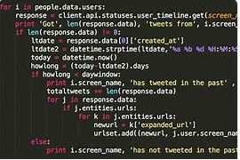
PET 328: Computer Applications in Petroleum Engineering – with Python Programming Dr. Mosobalaje, O. O.
PREAMBLES
Introduction to Computer Programming
A program is simply a collection of sequential Python statements written to perform a specific task

Slide 37
PET 328: Computer Applications in Petroleum Engineering – with Python Programming Dr. Mosobalaje, O. O.
PREAMBLES
Introduction to Computer Programming
Fundamental patterns (concepts) in a program
The following are typical patterns (statement(s)) you see in a program:
Input statements
Output statements
Sequential execution
Conditional statements
Repeated execution (loops)
Reuse of statements (functions)

Slide 38
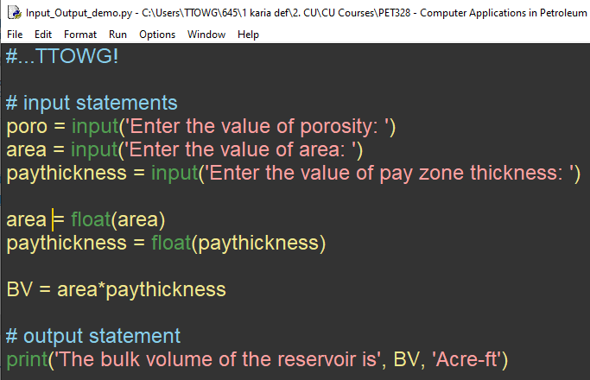
PET 328: Computer Applications in Petroleum Engineering – with Python Programming Dr. Mosobalaje, O. O.
PREAMBLES
Introduction to Computer Programming
Fundamental patterns (concepts) in a program
Input statements: - used to request and accept data from users
Example: the input function.

Slide 39
PET 328: Computer Applications in Petroleum Engineering – with Python Programming Dr. Mosobalaje, O. O.
PREAMBLES
Introduction to Computer Programming
Fundamental patterns (concepts) in a program
Output statements: - used to display the results of execution on the screen.
Example: the print function

Slide 40
PET 328: Computer Applications in Petroleum Engineering – with Python Programming Dr. Mosobalaje, O. O.
PREAMBLES
Introduction to Computer Programming
Fundamental patterns (concepts) in a program
Sequential execution: - typically, a program would entail multiple statements.
Statements are executed in the order (sequence) in which they are encountered.
Latter statements can make use of results of former statements; not vice-versa

Slide 41
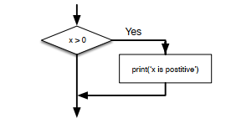
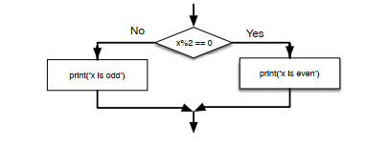
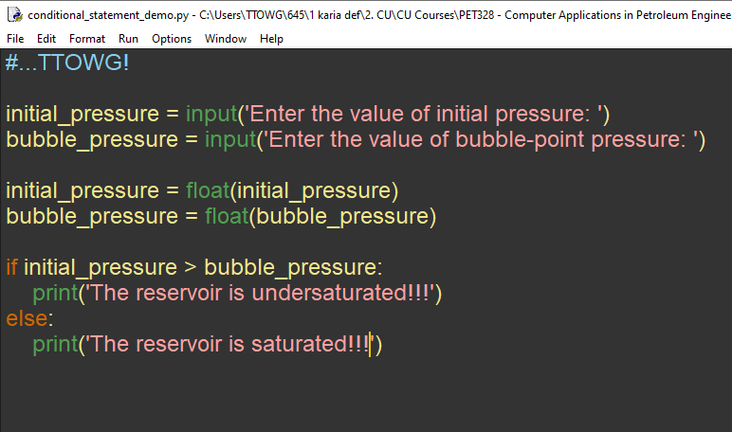
PET 328: Computer Applications in Petroleum Engineering – with Python Programming Dr. Mosobalaje, O. O.
PREAMBLES
Introduction to Computer Programming
Fundamental patterns (concepts) in a program
Conditional Statements: patterns that make it possible for the program to check for some conditions and decide to:
perform a statement(s) or skip the statement(s)
Choose between alternative statements.

Slide 42
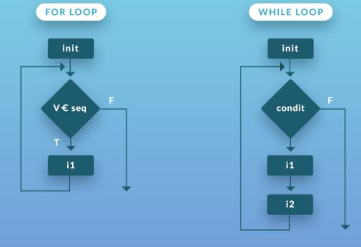
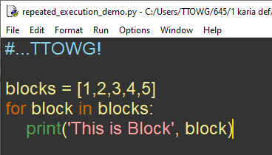
PET 328: Computer Applications in Petroleum Engineering – with Python Programming Dr. Mosobalaje, O. O.
PREAMBLES
Introduction to Computer Programming
Fundamental patterns (concepts) in a program
Repeated Execution: patterns that instructs the program to perform (iterate) a given statement(s) repeatedly, for each item in a set of items, varying values of parameter(s) from item to item.

Slide 43
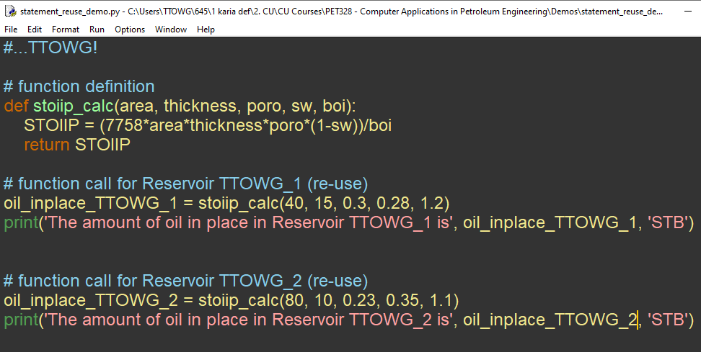
PET 328: Computer Applications in Petroleum Engineering – with Python Programming Dr. Mosobalaje, O. O.
PREAMBLES
Introduction to Computer Programming
Fundamental patterns (concepts) in a program
Re-use of statements: the task performed by some statement(s) might be routine and needed at various points in your program.
Such statement(s) may be written once, saved with a name and re-used at various points in your program by referring to the name.

Slide 44
>>>#TTOWG!
>>>print(‘…to the only wise God’)

Slide 45
PET 328: Computer Applications in Petroleum Engineering – with Python Programming Dr. Mosobalaje, O. O.
GETTING STARTED WITH PYTHON
Coming Soon…
Season 1 Episode 2 –
Getting Started with Python

Slide 46
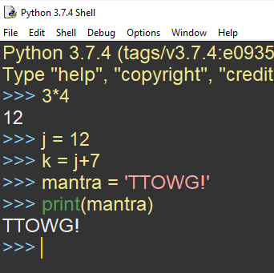
PET 328: Computer Applications in Petroleum Engineering – with Python Programming Dr. Mosobalaje, O. O.
GETTING STARTED WITH PYTHON
Basic Python Objects
Crudely speaking, Python objects are stuffs upon which actions (specified in python commands) are performed.
Example: in the code screenshot shown, 3, 4, j, k, 7, mantra, ‘TTOWG’ are all objects acted upon.

Slide 47
PET 328: Computer Applications in Petroleum Engineering – with Python Programming Dr. Mosobalaje, O. O.
GETTING STARTED WITH PYTHON
Basic Python Objects
The basic Python objects considered here are Values and Variables.
Later, some sets of sophisticated objects known as data structure shall be considered.

Slide 48
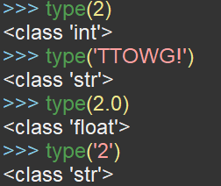
PET 328: Computer Applications in Petroleum Engineering – with Python Programming Dr. Mosobalaje, O. O.
GETTING STARTED WITH PYTHON
Basic Python Objects
Values
Values are simply the representation of data entities.
Types of Values
Values in Python belong to various types such as type integer, type float, and type string.
Use the function type to find out the type to which a value belong.

Slide 49
PET 328: Computer Applications in Petroleum Engineering – with Python Programming Dr. Mosobalaje, O. O.
GETTING STARTED WITH PYTHON
Basic Python Objects
Types of Values
2 is of type (class) integer
‘TTOWG’ and ‘2’ are of type string; just like any set of characters (alphanumeric and non-alphanumeric) enclosed in quotes
2.0 is of type float; just as are all numbers expressed in decimals.

Slide 50
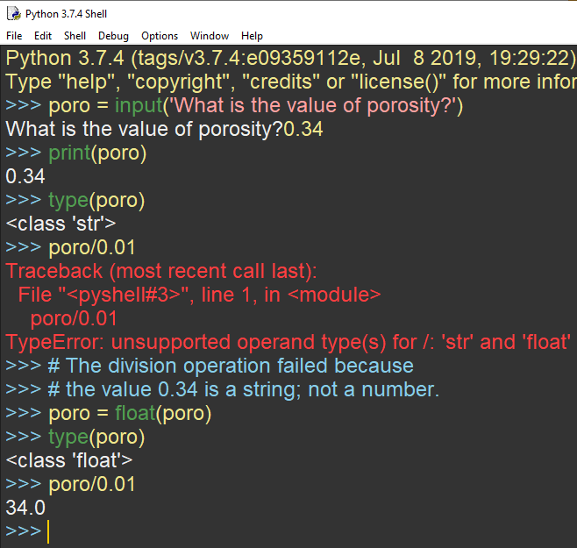
PET 328: Computer Applications in Petroleum Engineering – with Python Programming Dr. Mosobalaje, O. O.
GETTING STARTED WITH PYTHON
Basic Python Objects
Types of Values
Please, take note that users’ response to the input function prompt is stored as a string.
Before using such input in a mathematical operation, they should be converted to a numerical type using float or int functions.

Slide 51
PET 328: Computer Applications in Petroleum Engineering – with Python Programming Dr. Mosobalaje, O. O.
GETTING STARTED WITH PYTHON
Basic Python Objects
Variables
A variable is a value stored in memory and referred to with a chosen name.
In other words, values are assigned to variables.
When the name of a variable is called, the value assigned therein answers.

Slide 52
PET 328: Computer Applications in Petroleum Engineering – with Python Programming Dr. Mosobalaje, O. O.
GETTING STARTED WITH PYTHON
Basic Python Objects
Variables
A raw value can be assigned to a variable.
Example: j is a variable; the value 12 is assigned to it.
Also, the output of an expression (involving a variable) may be stored in another variable.
Example: k is a variable, the value obtained when j+7 is executed is subsequently assigned to variable k.
Not only numeric values are assigned to variables, strings are also assigned.
Example, mantra is a variable with string ‘TTOWG!’ assigned to it.

Slide 53
PET 328: Computer Applications in Petroleum Engineering – with Python Programming Dr. Mosobalaje, O. O.
GETTING STARTED WITH PYTHON
Basic Python Objects
Choosing Variable Names
In naming variable, the following rules are recommended:
Variable names should be descriptive, as much as possible. That is, the name should somewhat tell us something about the variable. Example: a variable to hold the value of reservoir permeability is better named ‘perm’ than named ‘x’
The name must be a single word. Where multiple words are necessary for descriptive purposes, they can be joined with the underscore character; e. g.: init_pressure.
Names should not be too long.
Names may contain both alphabets and numbers; but must not start with numbers.
Names are case sensitive. If you named a variable as ‘poro’, do not refer to it as ‘Poro’.
Avoid using special characters like ‘@’, ‘$’ in names.

Slide 54
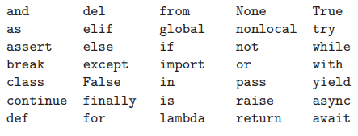
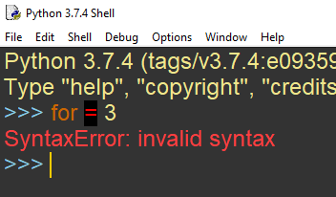
PET 328: Computer Applications in Petroleum Engineering – with Python Programming Dr. Mosobalaje, O. O.
GETTING STARTED WITH PYTHON
Basic Python Objects
Keywords
Keywords are words that are reserved for Python’s in-built structure.
Here is the list of Python’s keywords.
Keywords cannot be used as variable names; doing so would cause error.

Slide 55
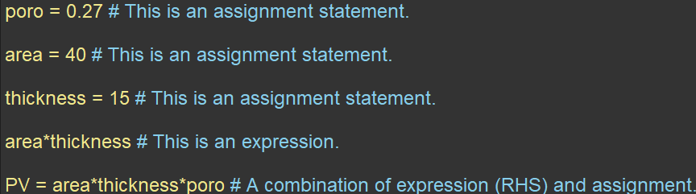
PET 328: Computer Applications in Petroleum Engineering – with Python Programming Dr. Mosobalaje, O. O.
GETTING STARTED WITH PYTHON
Basic Python Objects
Statements
A statement is simply unit of code (commands) that is interpretable and executable by Python; just like a sentence in natural language.
Two common types of Python statements are Assignment statements and Expressions.
Assignment statements simply assigns values to a variable.
An expression is a statement that combines variables, values, functions and operators.
A statement could combine both types such that the result of an expression (RHS) is assigned to a variable (LHS).

Slide 56
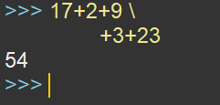
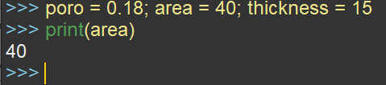
PET 328: Computer Applications in Petroleum Engineering – with Python Programming Dr. Mosobalaje, O. O.
GETTING STARTED WITH PYTHON
Basic Python Objects
Multi-line statements
Typically, a Python statement is written in a single line.
However, if the statement is too long, it could be continued in the next line; but the current line should end with the line continuation character i.e. \
Multiple statements in a line
Writing multiple statements in same line is not encouraged; however, if that has to be done, the statements should be separated by semicolon.

Slide 57
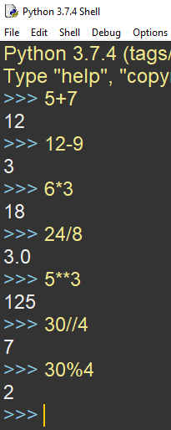
PET 328: Computer Applications in Petroleum Engineering – with Python Programming Dr. Mosobalaje, O. O.
GETTING STARTED WITH PYTHON
Basic Python Objects
Operators
Operators are symbols of mathematical operations.
+ for addition
- for subtraction
* for multiplication
/ for division
** for exponentiation (raise to power)
// integer division (truncates the result of division to its integer part.
% modulus (gives the remainder of an integer division).
The objects acted upon by operators are called operands.

Slide 58
PET 328: Computer Applications in Petroleum Engineering – with Python Programming Dr. Mosobalaje, O. O.
GETTING STARTED WITH PYTHON
Basic Python Objects
Order of Operations
When multiple operations are featured in a statement, Python executes them in the order specified by the accronym: PE-MD-AS (Parenthesis, Exponentiation, Multiplication, Division, and Subtraction).
You can used parenthesis to dictate the order you desire.
Multiplication and Division has equal precedence; hence are executed left to right.
Addittion and Subtraction has equal precedence; hence are executed left to right.
You may also use parenthesis to make an expression more readable and less confusing.
Nested parenthesis are executed from inside to outside.

Slide 59
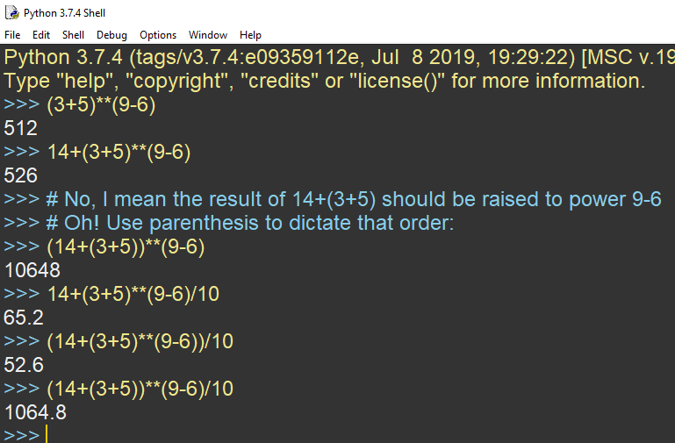
PET 328: Computer Applications in Petroleum Engineering – with Python Programming Dr. Mosobalaje, O. O.
GETTING STARTED WITH PYTHON
Basic Python Objects
Order of Operations
Consider the following operations to convince yourself of the PEMDAS order.

Slide 60
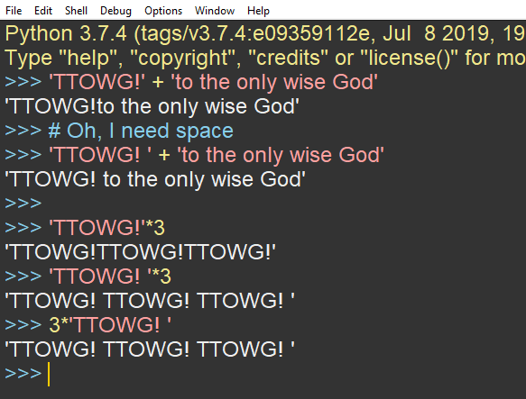
PET 328: Computer Applications in Petroleum Engineering – with Python Programming Dr. Mosobalaje, O. O.
GETTING STARTED WITH PYTHON
Basic Python Objects
String Operations
Strings can be joined end-to-end by using the + operator. If you want a space between the strings, then include it in one of the strings.
Also, a string can be repeated multiple times using the * operator (with and integer, of course).

Slide 61
PET 328: Computer Applications in Petroleum Engineering – with Python Programming Dr. Mosobalaje, O. O.
GETTING STARTED WITH PYTHON
Conditional Statements
Conditional statements are written to make it possible for a program to check for some conditions and decide to:
perform a statement(s) or skip the statement(s)
Choose between alternative statements.
So, the concept of condition is central to this kind of statements.
These conditions are crafted using the concept of Boolean expressions.

Slide 62
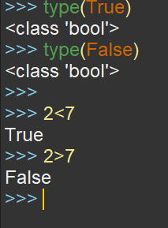
PET 328: Computer Applications in Petroleum Engineering – with Python Programming Dr. Mosobalaje, O. O.
GETTING STARTED WITH PYTHON
Conditional Statements
Boolean Expressions
A boolean is a value that is either True or False
Just like the integer type can take values 1, 2, 3 e.t.c; the boolean type can take one of just two values: True or False.
For this reason, ‘True’ and ‘False’ are Python keywords reserved for boolean values; a variable must not be named using these words.
Now, a boolean expression is essentially a comparison expression that evaluates to either True or False.

Slide 63
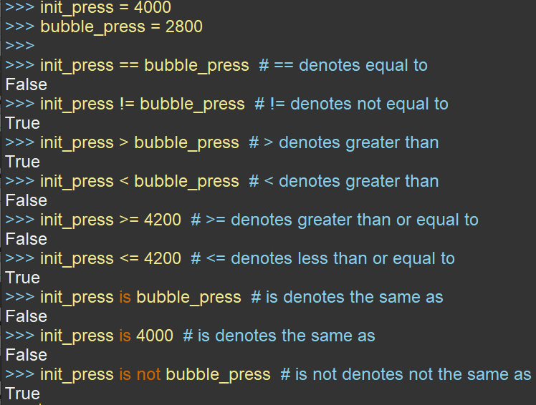
PET 328: Computer Applications in Petroleum Engineering – with Python Programming Dr. Mosobalaje, O. O.
GETTING STARTED WITH PYTHON
Conditional Statements
Boolean Expressions
Boolean expressions are constructed using comparison operators listed here.
Take note that = is an assignment operator while == is a comparison operator.

Slide 64
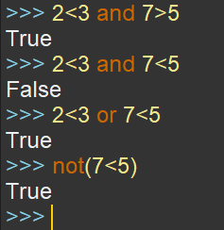
PET 328: Computer Applications in Petroleum Engineering – with Python Programming Dr. Mosobalaje, O. O.
GETTING STARTED WITH PYTHON
Conditional Statements
Logical Operators
Sometimes, multiple conditions needed to be checked in a conditional statement.
Logical operators are used to combine boolean expressions
and returns True if all conditions are true, true, otherwise, False is returned.
or returns True if one of the conditions is true, otherwise, False is returned.
Logical operators are also used to negate boolean expressions
not returns True for a false condition and vice-versa

Slide 65
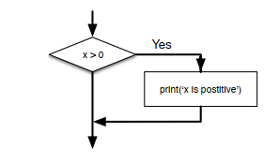
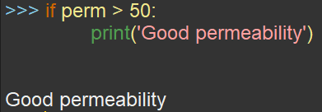
PET 328: Computer Applications in Petroleum Engineering – with Python Programming Dr. Mosobalaje, O. O.
GETTING STARTED WITH PYTHON
Conditional Statements
if statement
if statements evaluates the given condition; performs the given statement(s) if condition is true and skips the given statement(s) if condition is false.
The condition(s) is written after the if keyword and ended with a colon i.e. (:)
The statements to be performed or skip are written as an indented block in subsequent line(s).
Remove the indentation in lines after the if block.

